Slide 1
Case Study 1
Done by: Stonkers (JA2)

Slide 2

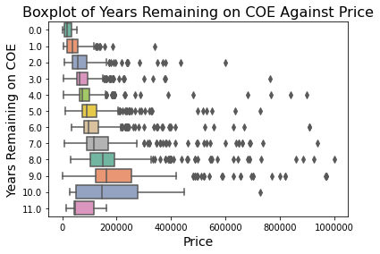
Finding the relationship between duration of COE left and the price
As the number of years remaining increases, the median price, as well as the maximum price, increases
From 4th year to 9th year, there is a steady and considerable increase in the 75th percentile price, as well as median and maximum price
As such, the Startup can consider prioritising listing vehicles with 4 to 9 years remaining on COE to increase potential revenue

Slide 3
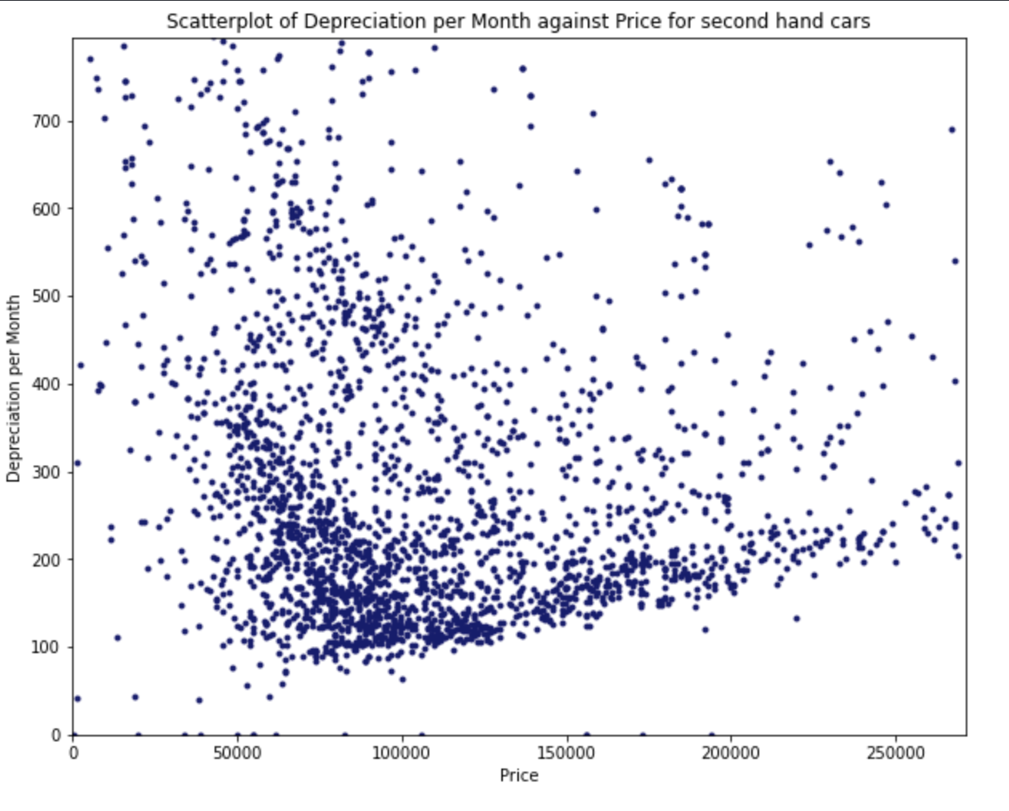
Finding the relationship between depreciation per month and the price of the car
Using Straight Line Depreciation Method: As the price of the car increases, the cost of depreciation per month increases.
From the scatterplot, there is no clear relationship between the price of the car and monthly depreciation of a car.

Slide 4
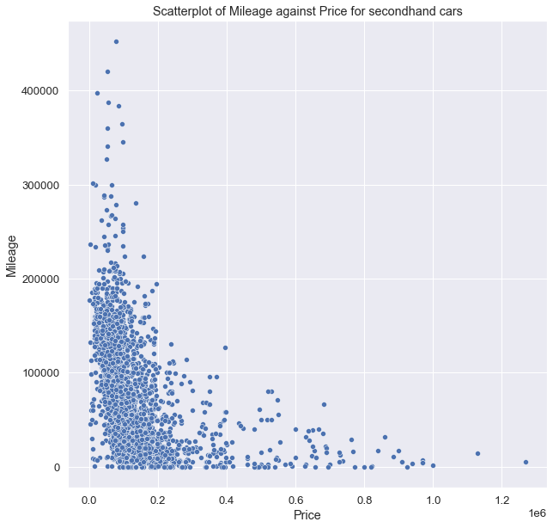
Finding the relationship between mileage on a used car and its price
As the price of a used car increases, the mileage on the car decreases
Indicative of a nonlinear relationship, i.e., exponential decrease in price with mileage
The Startup can prioritise listing vehicles with less than 200,000km of mileage to increase revenue

Slide 5
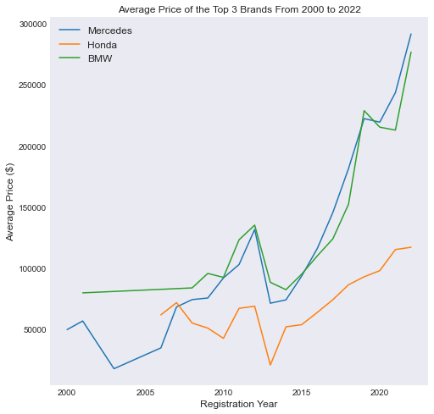
Pricing Strategy that the Startup should adopt
The Startup can analyse the average price trend of the different car brands over the years across different competitors
There is a clear upward trend in the average price over the years
The Startup can expect to price its used cars at a highly competitive price and potentially predict future prices for cars registered in the near future

Slide 6
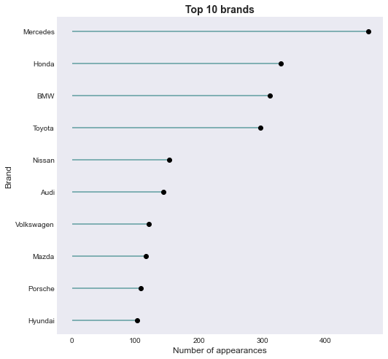
Analyzing the brands that are listed on the competitors’ website, the top brands that the Startup should ideally sell were identified
The Startup possess second-mover advantage since they will know which brands are the most sought after in the market from competitors
With the implementation of Singapore Green Plan 2030, Internal Combustion Engine (ICE) vehicles will slowly be phased out by 2040. Thus, the Startup may also consider selling Electric Vehicles (EVs) of these brands to establish itself as the market leader for used EVs

Slide 7
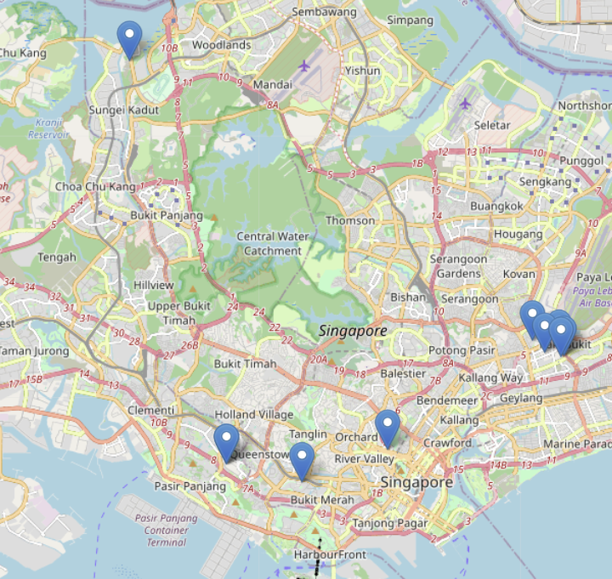
Should the startup decide to open a dealership, it should be done strategically to ensure optimal footfall
3rd
There are 3 possible locations that the startup can open a dealership if they choose to do so
1st option is the most optimal because many of the established used car dealerships in Singapore are located there
2nd option is also possible but option 3 is strongly not recommended due to its secluded location
1st
2nd

Slide 8
Thank You!

